Slide 1

PASSWORD CRACKING USING PERMUTATIONS OF GIVEN STRING
DIVYA P HATHWAR 1DS17CS035
CHANDANA VIJAYAKUMAR 1DS17CS033
GAURI PANDIT 1DS17CS038
Under the guidance of
Prof. Harish Kumar N
Assistant Professor, Dept. of CSE, DSCE

Slide 2
ABSTRACT
In this given project, we use string matching technique to crack the given password. The password and the string must be of fixed length 5.
To generate all permutations of a String , we create an empty Array List to store (partial) permutations and initialize the list with the first character of the string.
The previously constructed partial permutation is then iterated backwards. Then we remove current partial permutation from the Array List and insert next character of the specified string.
Then insert each of these newly constructed string in the list.
If the string equals array, then "password correct" is displayed else we display "password incorrect”.

Slide 3
TABLE OF CONTENT
Introduction 4
Design/ Implementation 5-7
Output 8-10
Conclusion 11
Future Work 12
References 13

Slide 4
INTRODUCTION
A permutation, also called an “arrangement number”, is a rearrangement of the elements of an ordered list S into a one-to-one correspondence with S itself. A string of length n has n! permutation.
Printing all permutations of a given string is an example of backtracking problem.
String Matching is the classical and existing problem in which one or several strings called " Pattern " is to be searched within a well-built string or " Text ".
A few of its imperative applications are Spell Checkers, Spam Filters, Intrusion Detection System, Search Engines,Bioinformatics, Digital Forensics and Information Retrieval Systems etc.

Slide 5
ALGORITHM:
TO FIND GIVEN PERMUTATIONS:
Read a string
Create an empty array list to store permutations
Initialize the list with first character of string
Do for every character using for loop
Remove current partial permutations from list
Backtrack and insert next character in all possible appositive of current partial permutations
Insert all the strings in the list

Slide 6
STRING MATCHING ALGORITHM:
Array list is converted to array arr[i]
Read the string with which you want to match the permutations with
Using for loop check the password with all permutations in array
If password == arr[i]
Print password correct
Else print password not correct

Slide 7
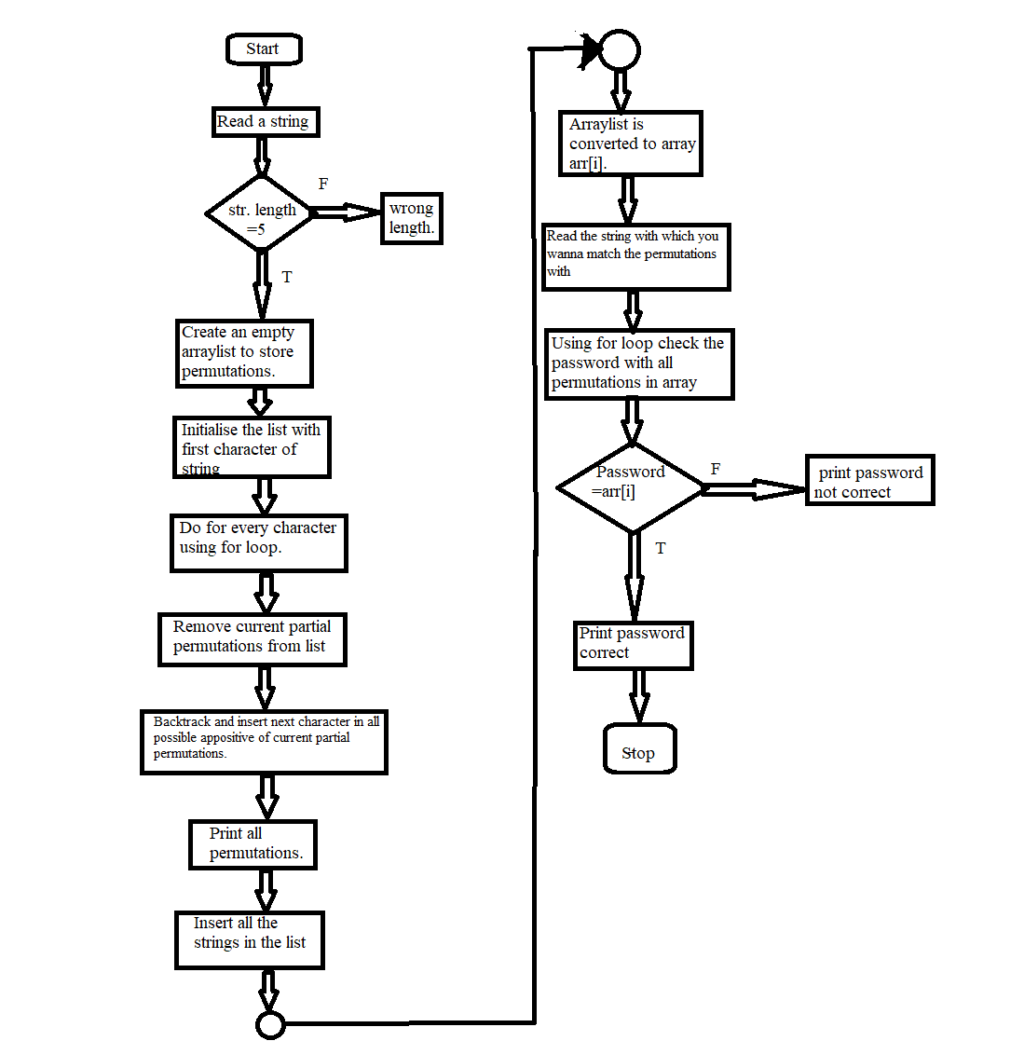
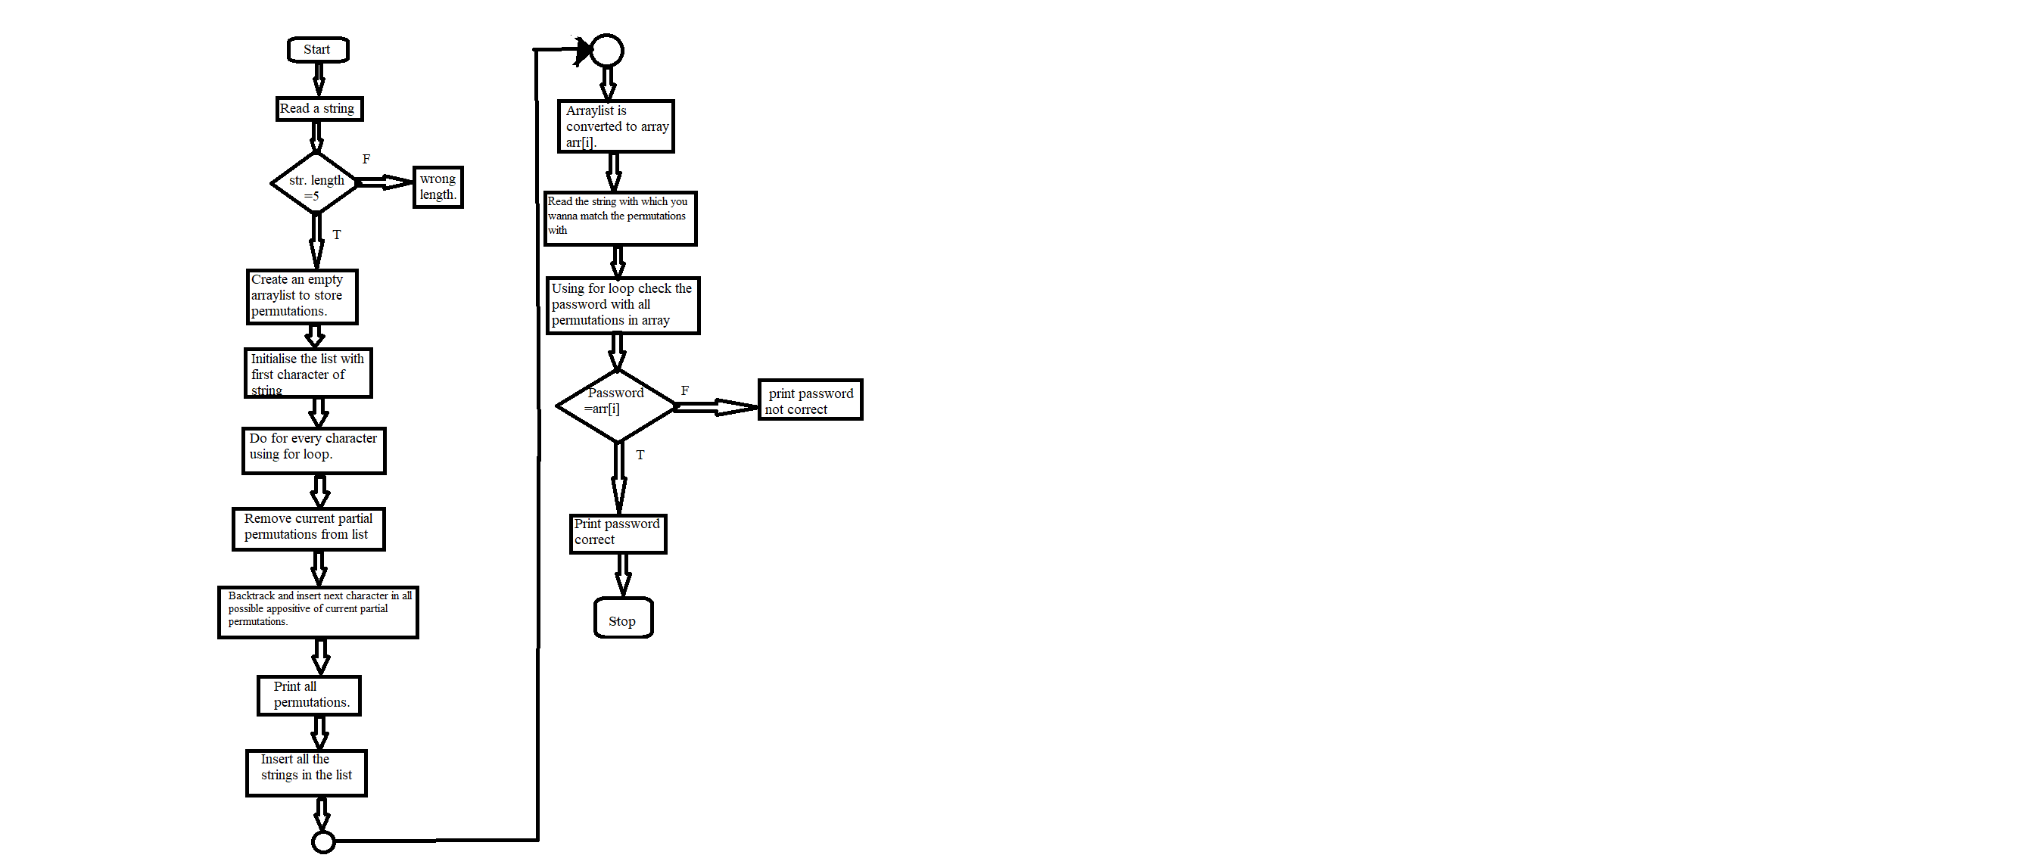
DESIGN AND IMPLEMENTATION

Slide 8
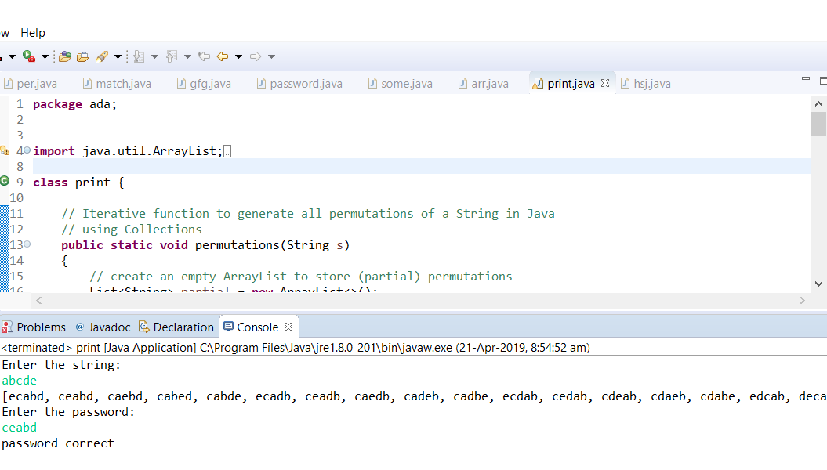
OUTPUT RUN-1

Slide 9

OUTPUT RUN-2

Slide 10

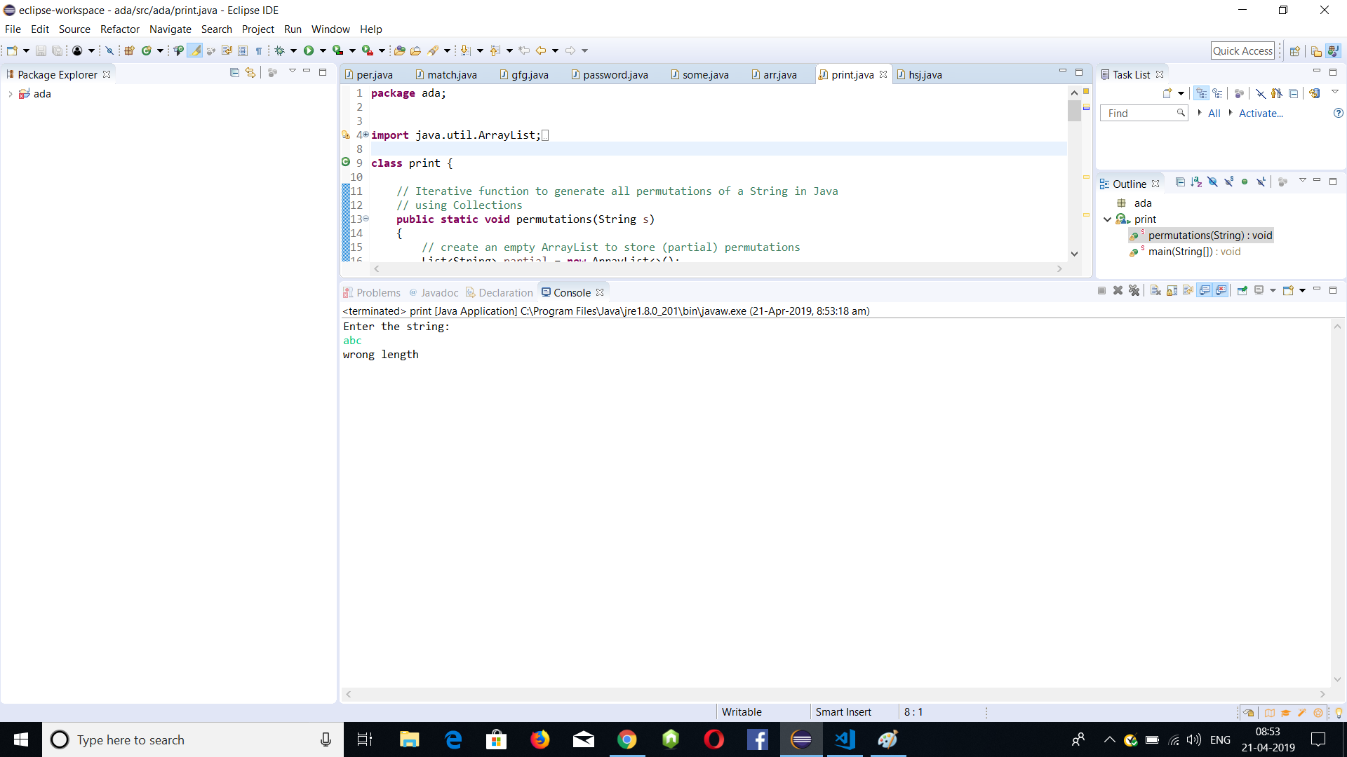
OUTPUT RUN-3

Slide 11
CONCLUSION
In the project, we crack the password using the permutations of the given string by using string matching technique.
We also print the permutations of the given string. Including to this, we understand the functionality of string matching algorithm.

Slide 12
FUTURE UPDATES
We can create a system which notifies the user when the password is placed incorrectly multiple times.

Slide 13
REFERENCES
https://www.geeksforgeeks.org/kmp-algorithm-for-pattern-searching/https://dzone.com/articles/how-to-parse-json-data-from-a-rest-api-using-simpl
Christian Charras and Thierry Lecroq,” Handbook of Exact String_Matching Algorithms”, Published in King’s college publication, Feb 2004
Alberto Apostolico and ZviGalil,” Pattern Matching Algorithms” Published in Oxford University Press, USA, 1st edition, May 29, 1997.
Hyunjin Kim, Hong-Sik Kim and Sungho Kang,"A Memory-Efficient Bit-Split Parallel String Matching Using Pattern Dividing for Intrusion Detection Systems” IEEE Transactions on Parallel and Distributed Systems, Volume:22 , Issue: 11, pp. 1904-1911, Nov 2011

